Slide 1

Computer Graphics Mini Project
Atharva Deshpande
Shreyas Chavhan
Shreeyash Borse

Slide 2
A MAN WALKING IN RAIN!!
INTRODUCTION
In this Computer Graphics Mini-Project , we tried to make a graphically designated MAN, A Cloud, Rain, and An Umbrella with the application of Computer Graphics codes.

Slide 3
METHODOLOGY
This project was done with the help of C++ Programming language.
Most of the graphic functions are coded on its header file <graphics.h>.

Slide 4
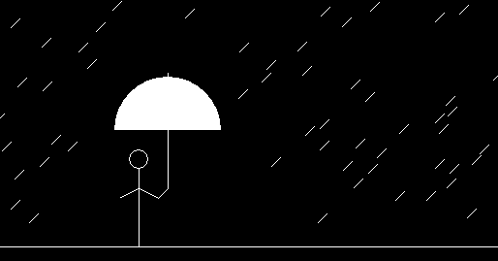
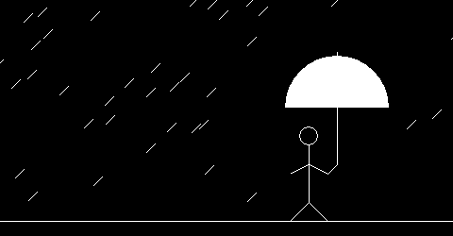
The main function in the code is responsible to achieve translation.

Slide 5
Some of the functions included in <graphics.h> used in our project: 1) Line function: Line function is used to draw a line from a point (x1,y1) point (x2,y2) i.e. (x1,y1) and (x2,y2) are the end points of the line. Declaration:- void line(int x1, int y1, int x2, int y2); 2) Circle function: Circle function is used to draw a circle with center (x,y) and third parameter specifies the radius of the circle. Declaration:- void circle(int x, int y, int radius);

Slide 6
3) Pieslice function: Pieslice function is used to draw a semicircle with center (x,y) , a starting angle , an ending angle, and the radius of the semicircle. Declaration:- void pieslice(int x, int y, int stangle, int endangle, int radius) 4) Arc function : An arc function is used to draw an arc with center(x,y) , a starting angle , an ending angle, and the radius of the arc. Declaration:- void arc(int x, int y, int stangle, int endangle, int radius)

Slide 7
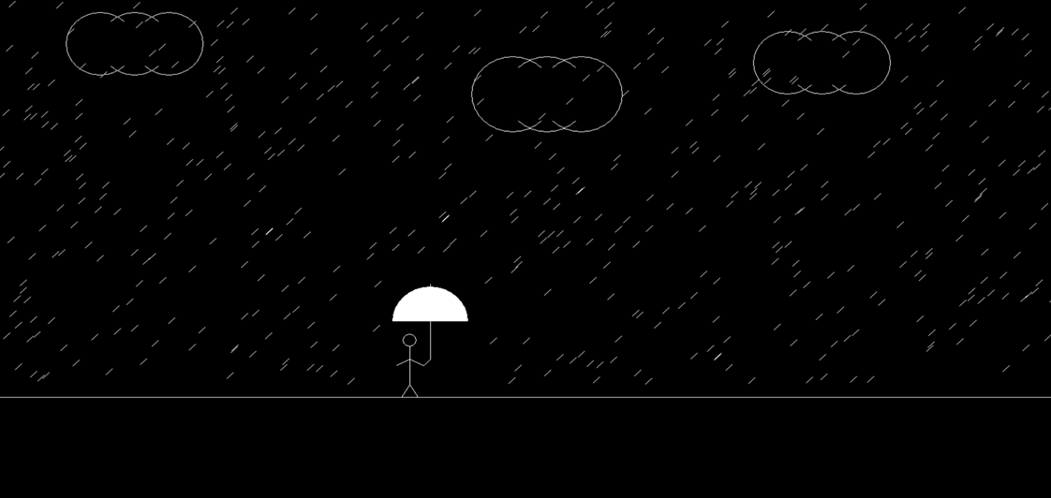
GRAPHIC OUTPUT

